Slide 1
Analyzing Digital Marketing Campaigns Using Machine Learning to Predict Sales
Predicting Conversion Rates and Optimizing Campaign Strategies
Christopher Nichols, Isagani Hernandez, Bijay Upadhyaya
DTSC 5502 Online

Slide 2
Why is marketing campaign analysis important?
Marketing campaigns are a crucial part of business strategy. By understanding what works and what doesn’t, businesses can optimize their marketing spend and increase conversion rates.
Many businesses struggle to understand the effectiveness of their campaigns, especially with large and complex datasets. This project aims to provide a solution, using machine learning, that can offer insights in what features would be most important in making marketing decisions.

Slide 3
Project Goals
Primary Goal: Predict the effectiveness of marketing campaigns by analyzing features such as ad spend, campaign duration, audience reach, and more.
Sub-goals:
Predict conversion rates based on various marketing factors.
Identify the most important features that influence campaign success.
Create a model that businesses can use to make data-driven decisions.

Slide 4
Data Overview
Dataset: 10,000 samples with 43 features (e.g., ad spend, campaign duration, engagement metrics, audience demographics).
Features:
Ad Spend: How much was invested in the campaign.
Industry Type: E-commerce, finance, healthcare, etc.
Marketing Channel: Social media, email, influencer, search engine, etc.
Audience Type: Urban, suburban, 18-34, 35-54, etc.
Target Variable: Conversion Rate: The proportion of people who took the desired action after engaging with the campaign (e.g., purchasing a product).
Data Cleaning and Feature Engineering:
Some features required one-hot encoding (e.g., categorical data like industries and target audiences).
Interaction terms such as ad_spend_duration and conversion_rate_audience_urban were created to capture non-linear relationships.

Slide 5
Key Observations From Our Correlation Matrix:
High Correlations:
Engagement Metric vs. Audience Reach: The correlation is very high (0.911), indicating that these two features are strongly related. This could suggest redundancy, and we might need to decide whether to keep both features or combine them in some way (e.g., by averaging, combining or selecting one based on predictive power).
Moderate Correlations:
Ad Spend vs. Budget Allocation: There is a moderate positive correlation (0.445), suggesting that campaigns with higher ad spend tend to have more allocated budget. This makes sense intuitively and implies some overlap between these features.
Low or Near-Zero Correlations:
Most other pairs, such as Conversion Rate vs. Ad Spend (-0.0015) or Duration vs. Success (-0.0043), have very low or negligible correlations. This suggests there might not be strong linear relationships among many of these features and the target variable (conversion_rate). However, we did combine Conversion Rate and Ad Spend into a new feature conversion_ad_spend
Negative Correlations:
Budget Allocation vs. Duration: A moderate negative correlation (-0.648) suggests campaigns with longer durations tend to have lower allocated budgets. This could be a factor worth exploring further to understand campaign planning strategies.
Audience Reach vs. Budget Allocation: A small negative correlation (-0.0106) might not be significant, but it could hint at minor inefficiencies in resource allocation for wider-reaching campaigns.

Slide 6
Methodology and Models Used
Machine Learning Models:
Linear Regression: Used to model the relationship between features and conversion rate.
Random Forests: A tree-based method to capture non-linear relationships and feature importance.
XGBoost: A powerful gradient boosting technique for improving predictive accuracy.
Why These Models?:
Linear Regression gives interpretability and a baseline performance.
Random Forests help capture more intricate relationships between features and tell which features are most important
XGBoost is powerful for improving predictive accuracy and handling diverse and high-dimensional data. Can also give insight to which features are most important

Slide 7
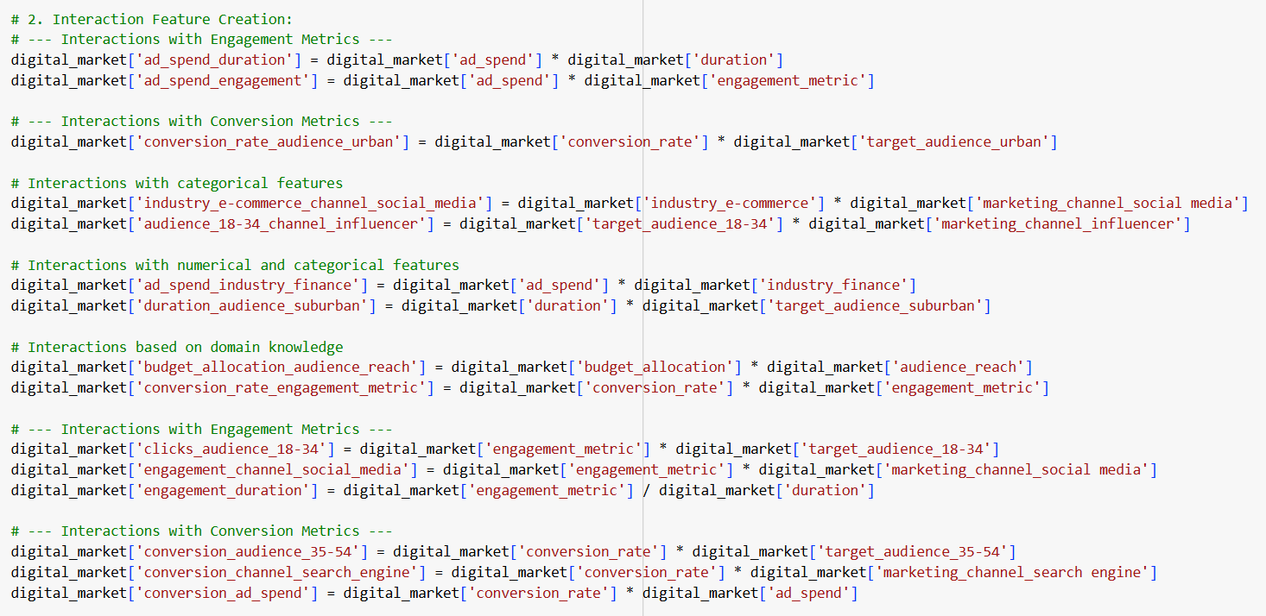
Feature Engineering
Key Features: Interaction terms like ad_spend_duration, conversion_rate_audience_urban, and others.
Why Feature Engineering?: Some features may not be directly useful, but by combining them, new relationships and patterns can possibly be discovered.
What Feature Engineering Did We Perform?: We determined features that showed colinearity and then created new features from these by multiplying closely related features together. This seems to do a great job allowing the various models we used to make accurate generalizations and see non-linear relationships. We learned this fact from how we engineered our columns features during the Kaggle Flood Challenge.

Slide 8
Design Decisions
Choice of Models:
XGBoost was chosen for its high accuracy in prediction tasks, Random Forests for its ability to handle complex data without overfitting, and Linear Regression as a baseline model to understand linear relationships. This project allowed us the opportunity to explore these powerful models not discussed in class
Data Preprocessing:
One-hot encoding was used for categorical variables. Some features were scaled for better performance in gradient-based models.
Challenges in Design:
The biggest challenge was feature selection—deciding which features were most relevant and how to handle potential multicollinearity and nonlinear relationships
Hyperparameter tuning was another challenge, especially for Random Forests and XGBoost. This was handled through grid search and cross-validation to improve model performance.

Slide 9
Results & Evaluation
Model Performance:
Linear Regression: It provided a baseline model with an MSE of 0.111 and a R² score of approximately 0.88, suggesting that there’s a moderate correlation between the features and conversion rate.
Random Forests: With an R-squared of 0.999 and an even lower MSE of 0.00124, the Random Forest model significantly improved prediction accuracy over Linear Regression by capturing complex interactions.
XGBoost: This model also did well, achieving an RMSE of 0.056 and a R-squared value of 0.997.
Which features were the most important for predicting conversion rates?:
It seems like ad_spend, conversion_ad_spend, ad_spend_engagement, conversion_ad_spend, and engagement_metric were the most important features after we did feature importance analysis.
Interaction Terms: Features like ad_spend_engagement and conversion_ad_spend indicate that interactions between budget and other factors (like engagement or conversion rate) are pivotal.
Efficiency Matters: Features emphasizing the return on investment—e.g., conversion_ad_spend—align directly with the business goal of maximizing conversions for minimal spending.
Audience Behavior: Engagement acts as a bridge between ad spend and conversion. Ads that fail to engage won’t convert, making engagement metrics critical.

Slide 10
What’s Next?
Improvements:
Implement further hyperparameter tuning for XGBoost and Random Forests to fine-tune the models.
Expand feature engineering by including more interaction terms or using advanced techniques like PCA for dimensionality reduction.
Future Work:
Deploying the Model: Build a web application where businesses can input their campaign details and get predictions on conversion rates.
Additional Metrics: Expand the analysis to include other marketing performance metrics like customer engagement or retention.

